Slide 1
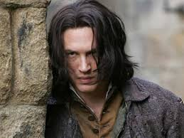
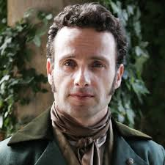
HEATHCLIFF and EDGAR
BY: KYLA
SKJONSBY

Slide 2
HATE
Edgar Linton Heathcliff

Slide 3
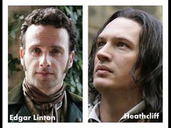
Quote:
“ Indeed, I shouldn’t have discovered that he had been there, except for the disarrangement of the drapery about the corpse’s face, and for observing on the floor a curl of light hair, fastened with a silver thread, which, on examination, I ascertained to have been taken from a locket hung around Catherine’s neck. Heathcliff had opened the trinket and cast out it’s contents, replacing them by a black lock of his own” (Bronte 164).

Slide 4
Paragraph:
This quote shows that Catherine keeped a lock of Edgar’s hair in her locket but, when she died Heathcliff went to go see the corpse he had looked inside the locket and saw a lock of Edgar’s hair but not his. So Heathcliff took Edgar’s lock of hair and though it on the floor replacing it with his own lock of hair. Nelly see what Heathcliff did so she took the two pieces of hair and twisted them together, then putting it in the locket.

